Slide 1
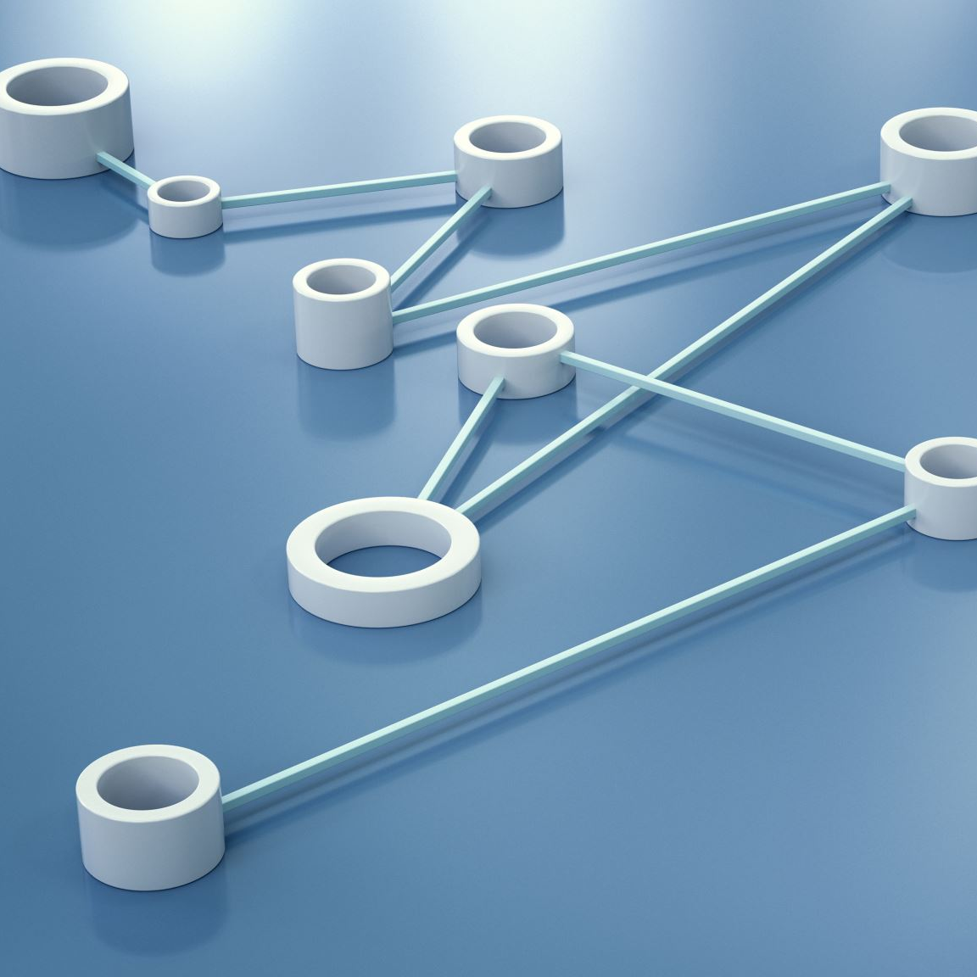
Rock-Paper-Scissor Project
Manar Shahin: 181036
Kawther Ahmed: 181025
Menna Shazely: 181037

Slide 2
Server.py
s = socket.socket(socket.AF_INET, socket.SOCK_STREAM)
try:
s.bind((server, port))
except socket.error as e:
str(e)
s.listen(3)
print("Waiting for a connection, Server Started")

Slide 3
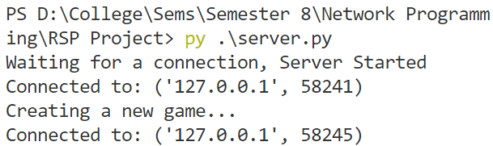
Server.py
while True:
conn, addr = s.accept()
print("Connected to:", addr) idCount += 1
p = 0
gameId = (idCount - 1)//2
if idCount % 2 == 1:
games[gameId] = Game(gameId)
print("Creating a new game...")
else:
games[gameId].ready = True
p = 1 start_new_thread(threaded_client, (conn, p, gameId))

Slide 4
Network.py
class Network:
def __init__(self):
self.client = socket.socket(socket.AF_INET, socket.SOCK_STREAM)
self.server = "127.0.0.1"
self.port = 5555
self.addr = (self.server, self.port)
self.p = self.connect()

Slide 5
Game.py
def play(self, player, move):
self.moves[player] = move
if player == 0:
self.p1Went = True
else:
self.p2Went = True

Slide 6
Game.py
def winner(self): p1 = self.moves[0].upper()[0]
p2 = self.moves[1].upper()[0] winner = -1
if p1 == "R" and p2 == "S":
winner = 0
elif p1 == "S" and p2 == "R":
winner = 1
elif p1 == "P" and p2 == "R":
winner = 0
elif p1 == "R" and p2 == "P":
winner = 1
elif p1 == "S" and p2 == "P":
winner = 0
elif p1 == "P" and p2 == "S":
winner = 1 return winner

Slide 7
Game.py
def bothWent(self):
return self.p1Went and self.p2Went
def resetWent(self):
self.p1Went = False
self.p2Went = False

Slide 8
Client.py
def menu_screen():
run = True while run:
clock.tick(60)
win.fill((179,205,224))
font = pygame.font.SysFont("Comic Sans MS", 40)
text = font.render("Click to Play!", 1, (0,0,0))
win.blit(text, (100,200))
pygame.display.update() for event in pygame.event.get():
if event.type == pygame.QUIT:
pygame.quit()
run = False
if event.type == pygame.MOUSEBUTTONDOWN:
run = False main()

Slide 9
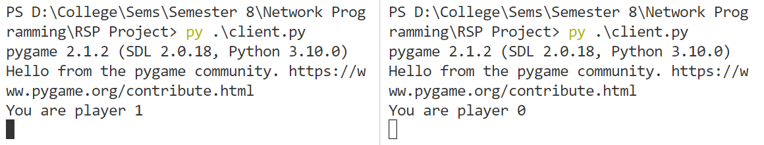
Client.py
def main():
run = True
clock = pygame.time.Clock()
n = Network()
player = int(n.getP())
print("You are player", player)

Slide 10
Client.py
font = pygame.font.SysFont("Comic Sans MS", 40)
text = font.render("Your Move", 1, (1,31,75))
win.blit(text, (80, 200)) text = font.render("Opponents", 1, (1,31,75))
win.blit(text, (380, 200))
move1 = game.get_player_move(0)
move2 = game.get_player_move(1)
if game.bothWent():
text1 = font.render(move1, 1, (148, 25, 50))
text2 = font.render(move2, 1, (148, 25, 50))
else:
if game.p1Went and p == 0:
text1 = font.render(move1, 1, (148, 25, 50))
elif game.p1Went:
text1 = font.render("Locked In", 1, (0, 0, 0))
else:
text1 = font.render("Waiting...", 1, (148, 25, 50))

Slide 11
font = pygame.font.SysFont("Comic Sans MS", 70)
if (game.winner() == 1 and player == 1) or (game.winner() == 0 and player == 0):
text = font.render("You Won!", 1, (148, 25, 50))
elif game.winner() == -1:
text = font.render("Tie Game!", 1, (148, 25, 50))
else:
text = font.render("You Lost...", 1, (148, 25, 50))
win.blit(text, (width/2 - text.get_width()/2, height/2 - text.get_height()/2))
pygame.display.update()
Client.py

Slide 12
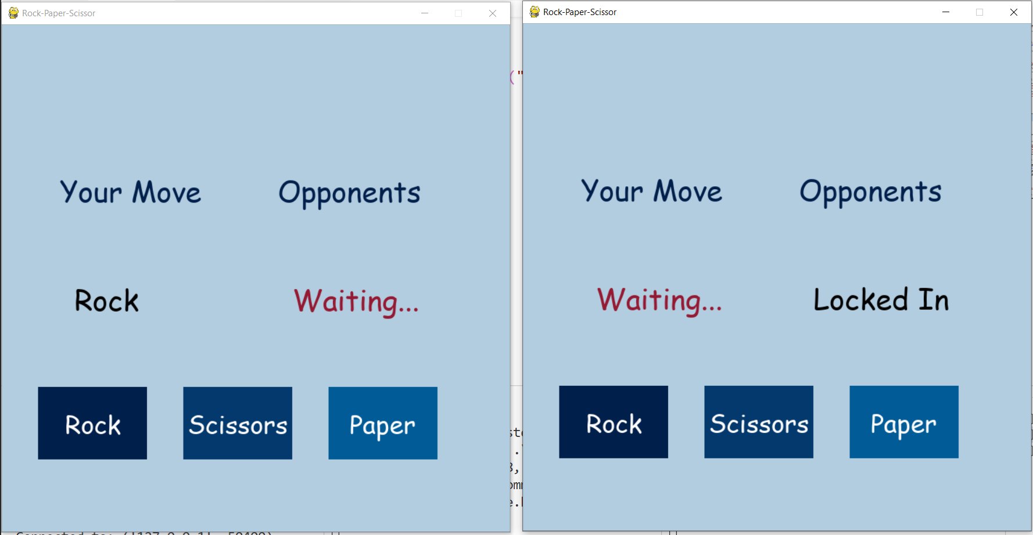

Slide 13
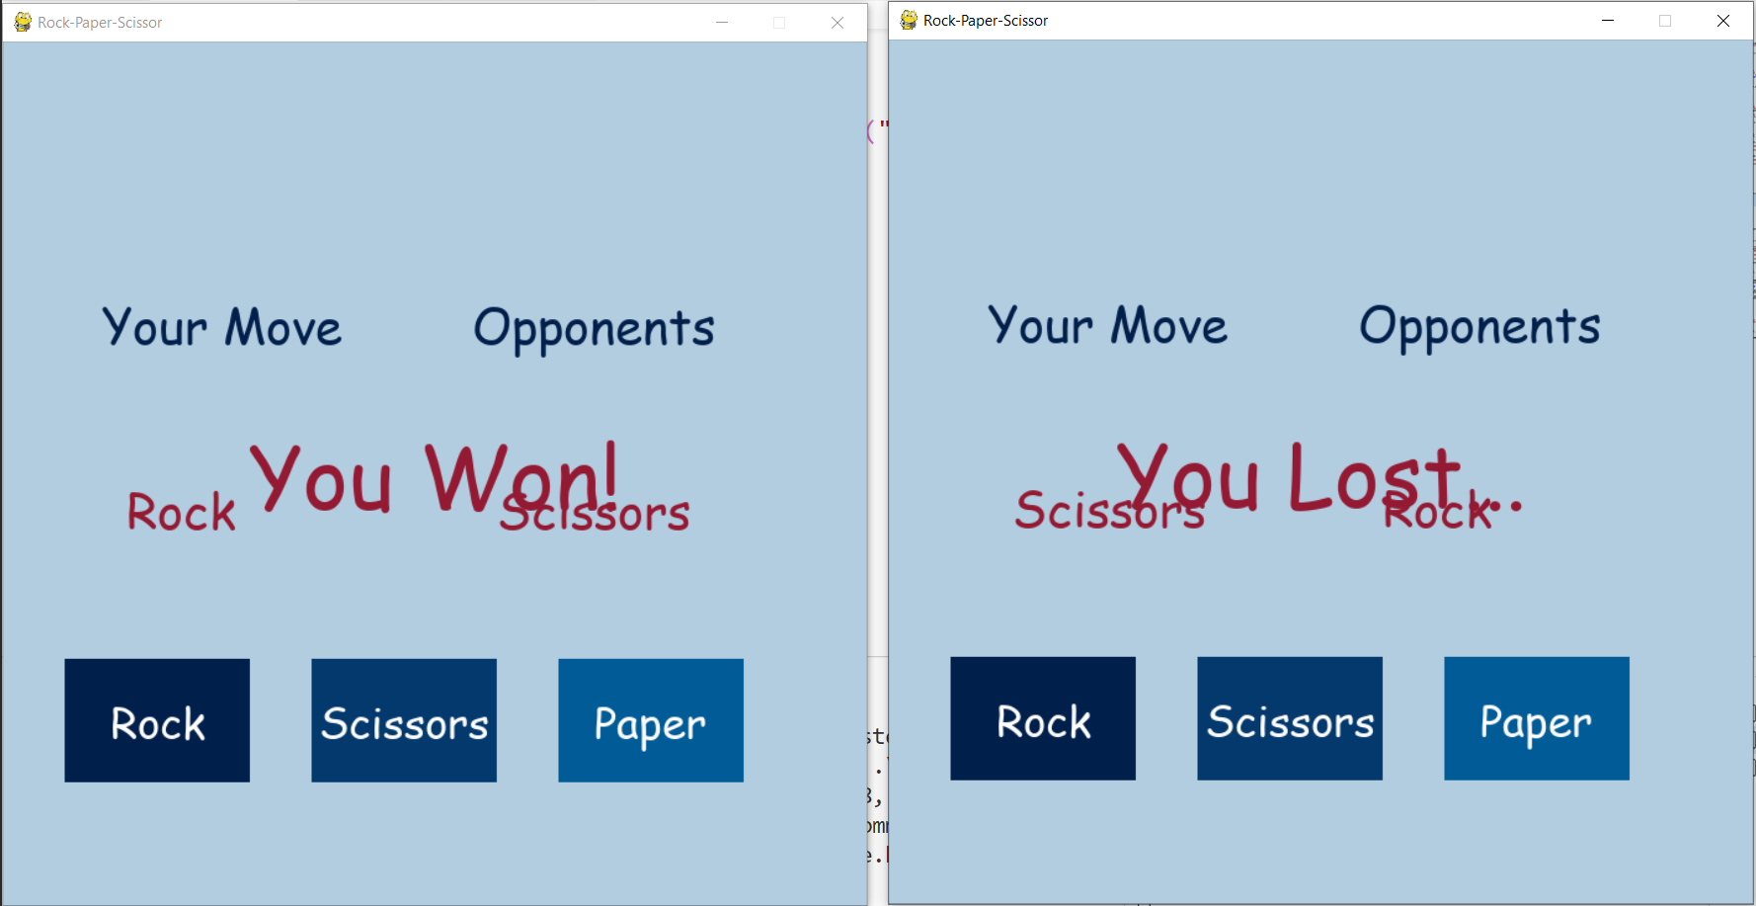

Slide 14
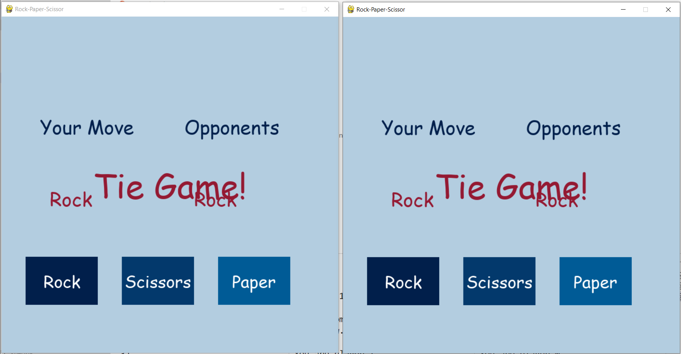

Slide 15
Project GitHub Link
https://github.com/ManarShahin48/Rock-Paper-Scissor-Game

Slide 16
Thanks

